Slide 1
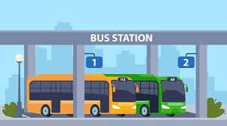
Bus Transport Service
Java Project Presentation
By
AJITH KUMAR D
Enrollment Number :EBEON0723819486
Batch :2023-10205

Slide 2
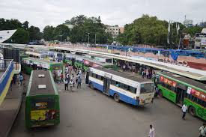
Introduction
The Bus Transport Service Java project is a simple application that provides details about a bus, its timings, and stops. This project is designed to showcase the basic structure of a bus transport service application.

Slide 3
2. Classes
2.1 Bus Class
The Bus class represents information about a bus, including its number, route, capacity, fare, and timing details.
Attributes:
busNumber (String): Unique identifier for the bus.
route (String): The route the bus follows.
capacity (int): Maximum number of passengers the bus can accommodate.
fare (double): The fare charged for a bus ticket.
busTiming (BusTiming): An instance of the BusTiming class representing the bus timings.
Methods:
displayDetails(): Displays all details of the bus, including timings.

Slide 4
2.2 BusTiming Class
The BusTiming class represents the timings for a bus on weekdays and weekends.
Attributes:
weekdays (String[]): Array of timings on weekdays.
weekends (String[]): Array of timings on weekends.
Methods:
displayTimings(): Displays both weekday and weekend timings.
2.3 BusStop Class
The BusStop class represents details about a bus stop, including its name and location.
Attributes:
stopName (String): The name of the bus stop.
stopLocation (String): The location of the bus stop.
Methods:
displayStopDetails(): Displays details about the bus stop.

Slide 5
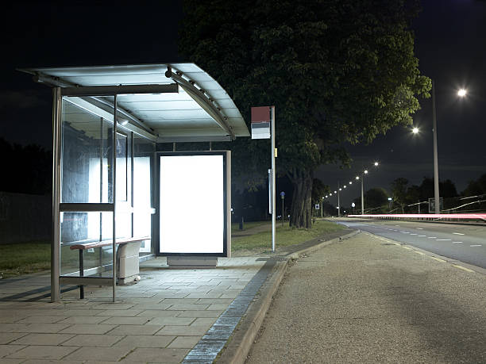
2.4 BusTransportService Class The BusTransportService class contains the main method and serves as the entry point for the application. Methods: main(String[] args): Takes user input to create instances of Bus, BusTiming, and BusStop, and then displays their details.

Slide 6
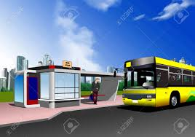
3. How to Run
Compile all Java files using a Java compiler:
Copy of Code:
The code was added in the Document you cant test there.

Slide 7
package busTransport;
import java.util.Scanner;
class Bus {
private String busNumber;
private String route;
private int capacity;
private double fare;
private BusTiming busTiming;
public Bus(String busNumber, String route, int capacity, double fare, BusTiming busTiming) {
this.busNumber = busNumber;
this.route = route;
this.capacity = capacity;
this.fare = fare;
this.busTiming = busTiming;
}
public void displayDetails() {
System.out.println("Bus Number: " + busNumber);
System.out.println("Route: " + route);
System.out.println("Capacity: " + capacity + " passengers");
System.out.println("Fare: $" + fare);
System.out.println("Bus Timings:");
busTiming.displayTimings();
}
}
class BusTiming {
private String[] weekdays;
private String[] weekends;
public BusTiming(String[] weekdays, String[] weekends) {
this.weekdays = weekdays;
this.weekends = weekends;
}
public void displayTimings() {
System.out.println("Weekdays Timings:");
for (String timing : weekdays) {
System.out.println(timing);
}
System.out.println("Weekends Timings:");
for (String timing : weekends) {
System.out.println(timing);
}
}
}
class BusStop {
private String stopName;
private String stopLocation;
public BusStop(String stopName, String stopLocation) {
this.stopName = stopName;
this.stopLocation = stopLocation;
}
public void displayStopDetails() {
System.out.println("Stop Name: " + stopName);
System.out.println("Stop Location: " + stopLocation);
}
}
public class BusTransport{
public static void main(String[] args)
{
Scanner scanner = new Scanner(System.in);
System.out.println("Enter Bus Number:");
String busNumber = scanner.nextLine();
System.out.println("Enter Route:");
String route = scanner.nextLine();
System.out.println("Enter Capacity:");
int capacity = scanner.nextInt();
System.out.println("Enter Fare:");
double fare = scanner.nextDouble();
System.out.println("Enter Weekdays Bus Timings (comma-separated):");
String[] weekdaysTimings = scanner.next().split(",");
System.out.println("Enter Weekends Bus Timings (comma-separated):");
String[] weekendsTimings = scanner.next().split(",");
BusTiming busTiming = new BusTiming(weekdaysTimings, weekendsTimings);
System.out.println("Enter Bus Stop Details:");
System.out.println("Enter Stop Name:");
String stopName = scanner.next();
System.out.println("Enter Stop Location:");
String stopLocation = scanner.next();
BusStop busStop = new BusStop(stopName, stopLocation);
Bus bus = new Bus(busNumber, route, capacity, fare, busTiming);
System.out.println("\nBus Details:");
bus.displayDetails();
System.out.println("\nBus Stop Details:");
busStop.displayStopDetails();
scanner.close();
}
}

Slide 8
4. Example Usage
4.1 Input
Enter Bus Number:
B001
Enter Route:
City Express
Enter Capacity:
50
Enter Fare:
10.50
Enter Weekdays Bus Timings (comma-separated):
08:00,12:00,16:00
Enter Weekends Bus Timings (comma-separated):
10:00,14:00,18:00
Enter Bus Stop Details:
Enter Stop Name:
Central Station
Enter Stop Location:
Downtown
4.2 Output
Bus Details:
Bus Number: B001
Route: City Express
Capacity: 50 passengers
Fare: Rs. 10.5
Bus Timings:
Weekdays Timings:
08:00
12:00
16:00
Weekends Timings:
10:00
14:00
18:00
Bus Stop Details:
Stop Name: Central Station
Stop Location: Downtown

Slide 9
5. Notes
This project is a basic representation and can be extended for more features and functionalities.
Input validation is minimal, and the project assumes correct user input for simplicity.
6. Customization
Feel free to customize and extend the project based on specific requirements. Additional features such as multiple stops, dynamic scheduling, and enhanced user interfaces can be implemented for a more comprehensive bus transport service simulation.

Slide 10
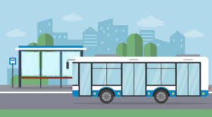
The END

